Slide 1

A1 - Needfinding
Team 2: JAI DED
Ecem “AJ” Yilmazhaliloglu
Alexander Yue
Diego Valdez Duran
Evan Hsu

Slide 2
TABLE OF CONTENTS
01
02
03
04
05
06
Intros
Problem Domain
Needfinding Methodology
Results
Interview Analysis
Summary

Slide 3

01
INTROS

Slide 4
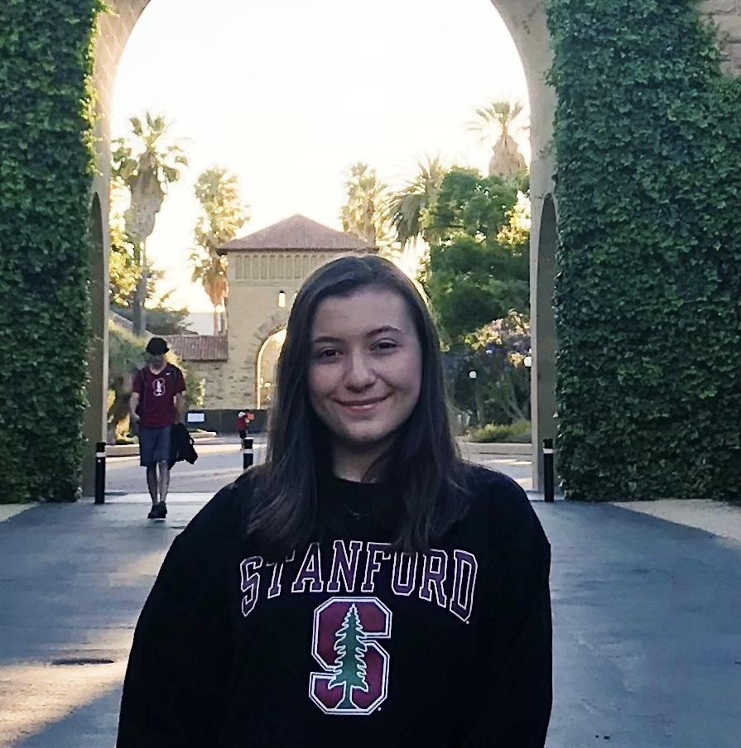
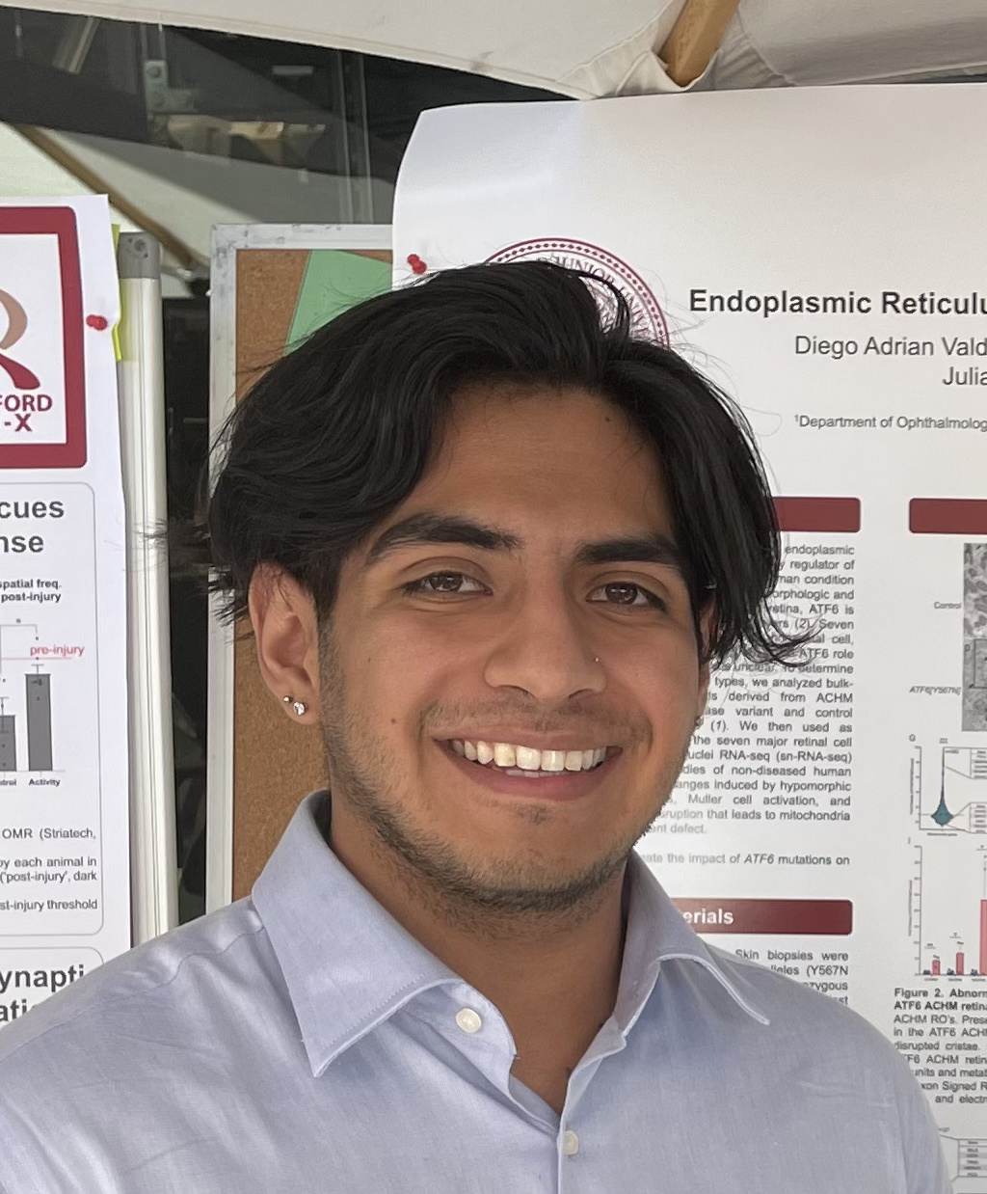
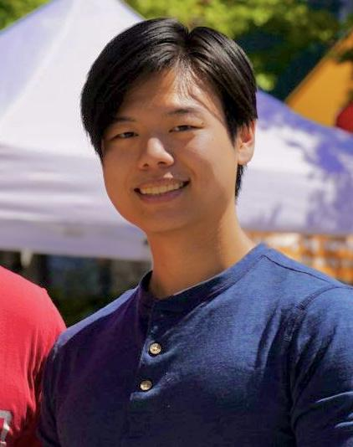
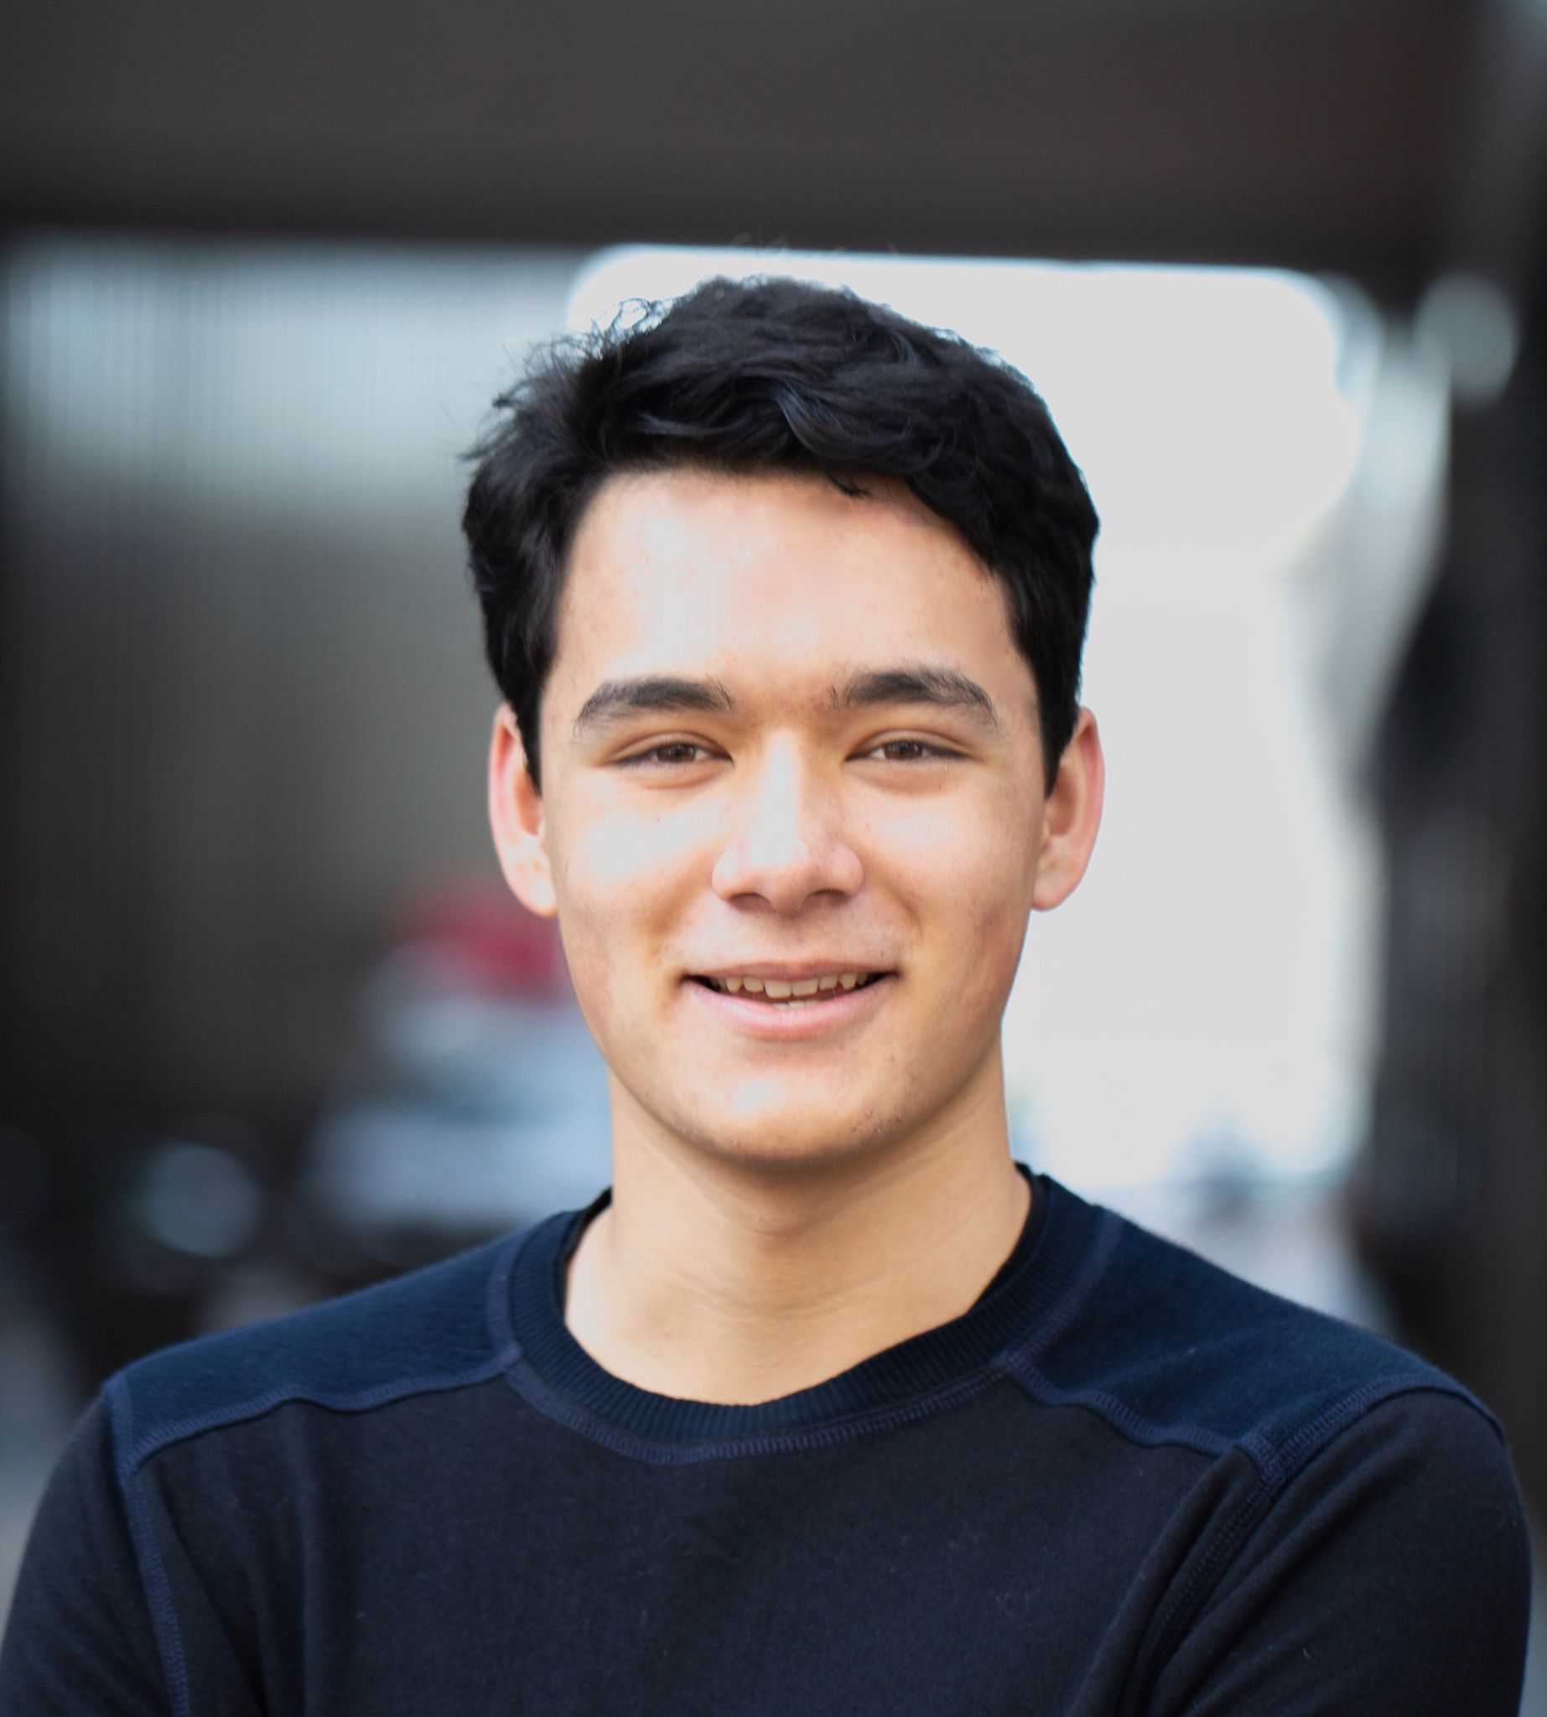
Meet The Team!
’25
Alexander Yue
Evan Hsu
’25
Coterm
Rancho Cucamonga, CA
BS Physics
Sacramento, CA
Ecem Yilmazhaliloglu
Diego Valdez Duran
BS CS
Istanbul, Turkey
Coterm CS
Aspen, CO
’27
’25

Slide 5

02
PROBLEM
DOMAIN

Slide 6

With the studio theme of AI in the Classroom in mind, we chose the following domain of interest:
People who use the US undergraduate education system

Slide 7

03
NEEDFINDING METHODS

Slide 8
Participants
Interviewee 1
Interviewee 3
Person taking a gap year after high school
Interviewee 2
Current student at UC Berkeley
Interviewee 4
Current student at UC Berkeley
A recent graduate from UC Davis
Usage of college education
Less extreme
More extreme

Slide 9
Missing Populations
Although we tried to interview a representative sample of US undergraduate student, some important groups were missing from our participant list:
Students with a documented disability
Students outside of California
Students enrolled in private universities
In addition, we did not survey demographic information, and so we cannot conclude that we have representative sample in terms of:
Ethnicity
Gender Identity
FLI status

Slide 10
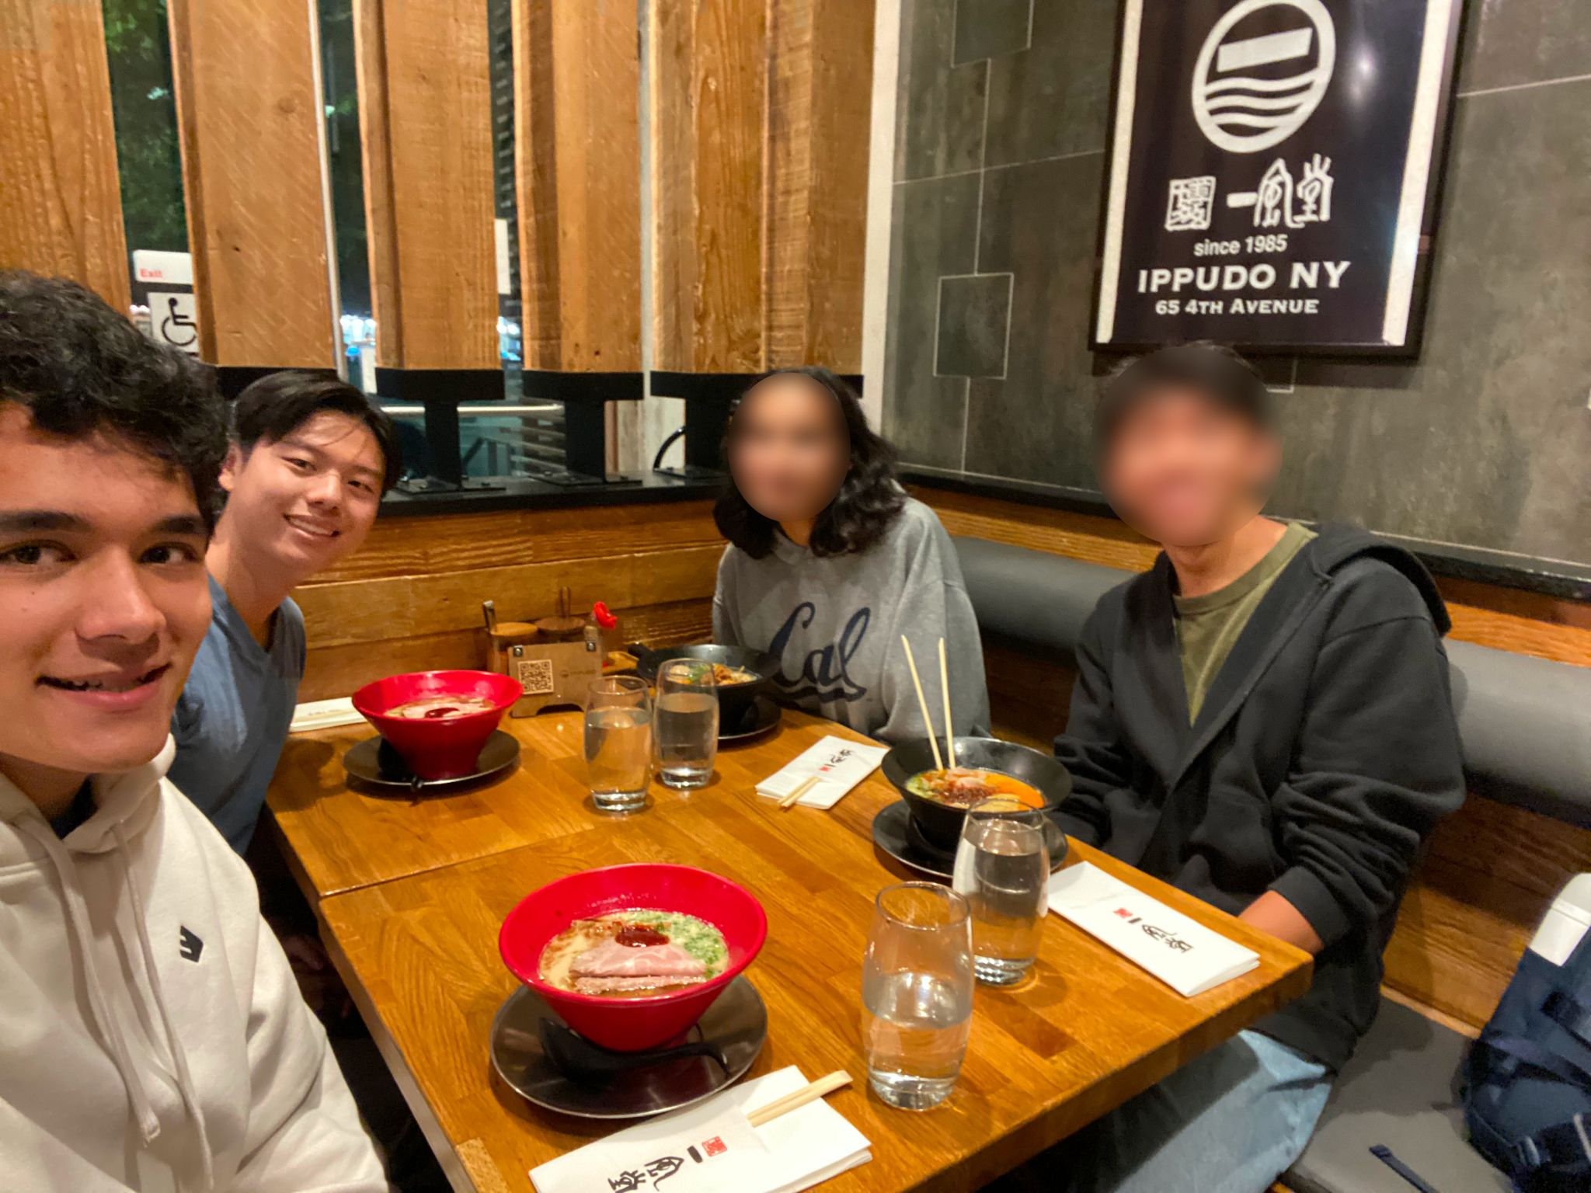
Example Interview Process
Interviewee 3
Contacted through friend of friend
Met in person at favorite restaurant in Berkeley
Built rapport while talking over dinner
Conducted interview after the meal, with Alex as interviewer and Evan as the note taker
Consented to audio recording only, was recorded by phone placed on table
Interview was 55 minutes long
Participant was compensated by paying for his dinner (as agreed upon prior)
Snowball Sampling–got a second interview with participant’s friend afterward
Image of us at restaurant with faces blurred

Slide 11
Starting Questions
How is this year at school different from your last?
What was your favorite class and why?
What was your least favorite class and why?
What are the most challenging parts of classes? How do you prepare for it?
How did you pick your major / concentration?

Slide 12

04
RESULTS

Slide 13


Interviewee 3
Sophomore at UC Berkeley
Hometown is Seattle
Public Health major
Is a pre-med student
Works in the Essig Museum of Entomology
Stock Image by garetsvisual on Freepik

Slide 14
Key Quotes
“My friends and I apply for the same classes together… we try to stick together because the study group goes really well. We tend to do better working together”
“I don't know anyone in one of my classes, so it's very hard to talk to people, maybe because I feel like they just already talk to other people.”
“Sometimes I see the same people around sitting nearby us. And, sometimes when our professor tells us to talk to each other, sometimes we engage with them as well, because they don't have anyone nearby to talk to”
“One person in our study group got, A+ … It's one of those people that is naturally smart. Like, get it. I think because their prior experiences, they took, like, linear algebra in high school, they took discrete math”

Slide 15
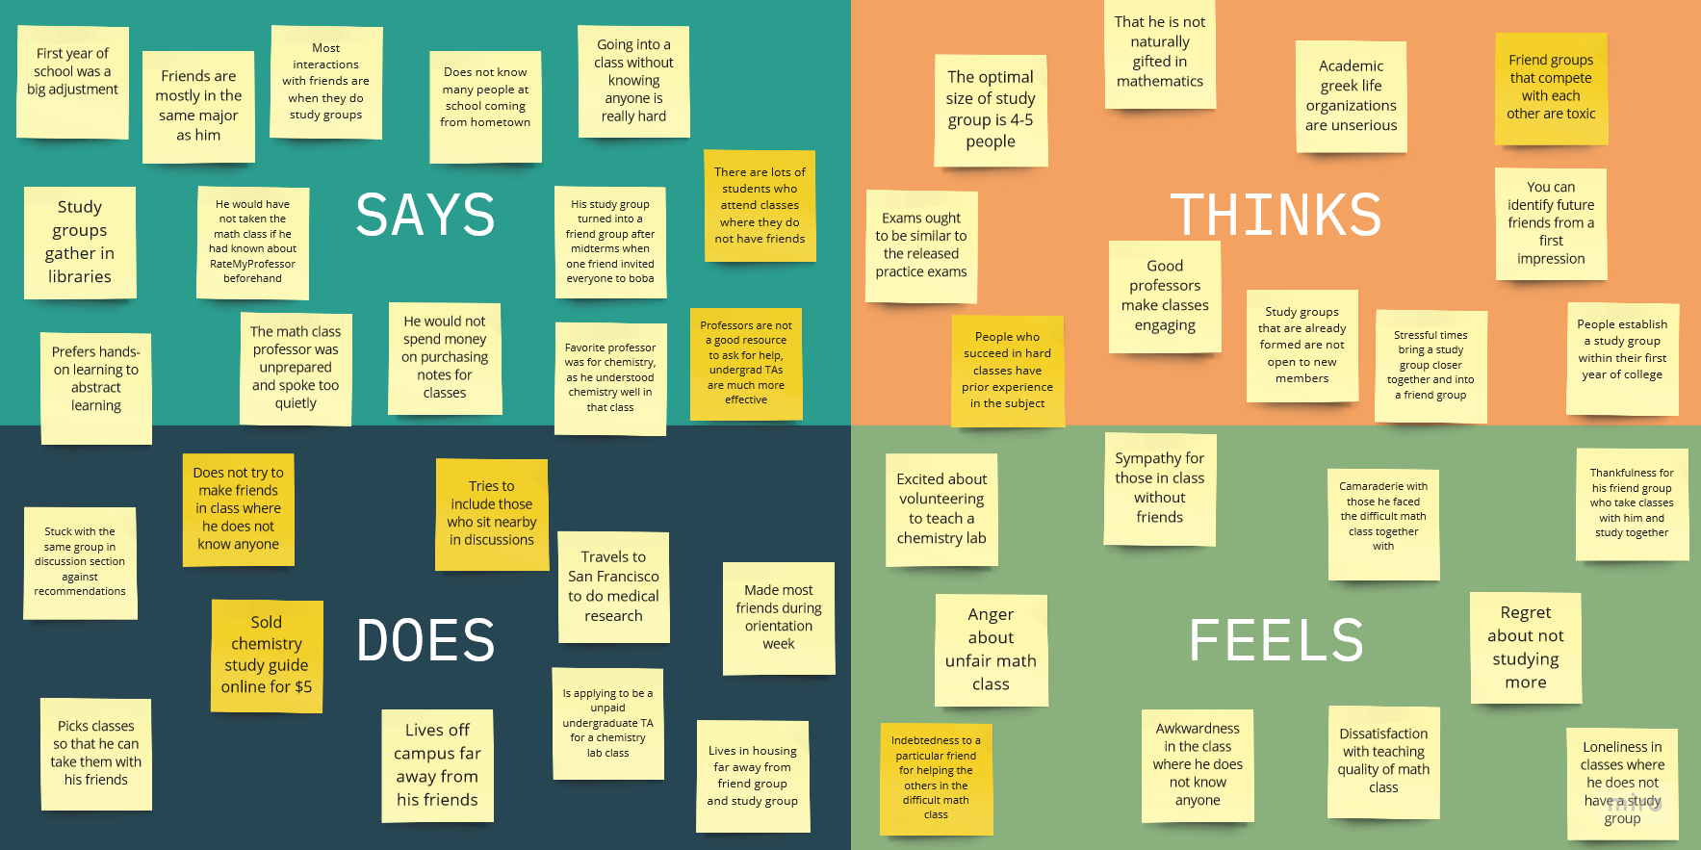

Slide 16
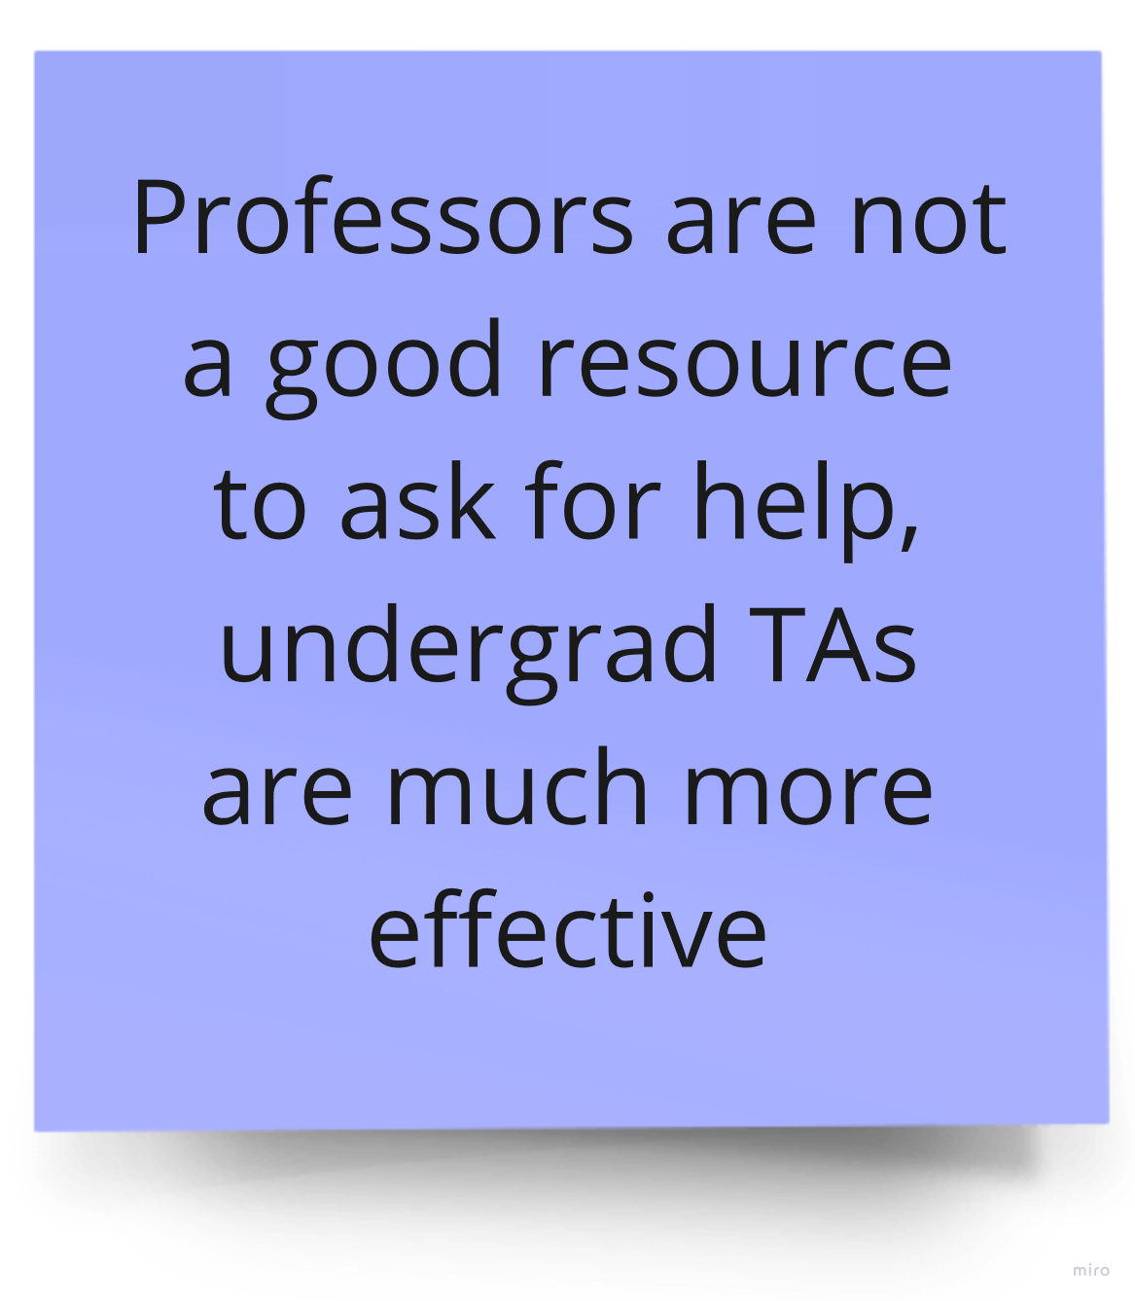
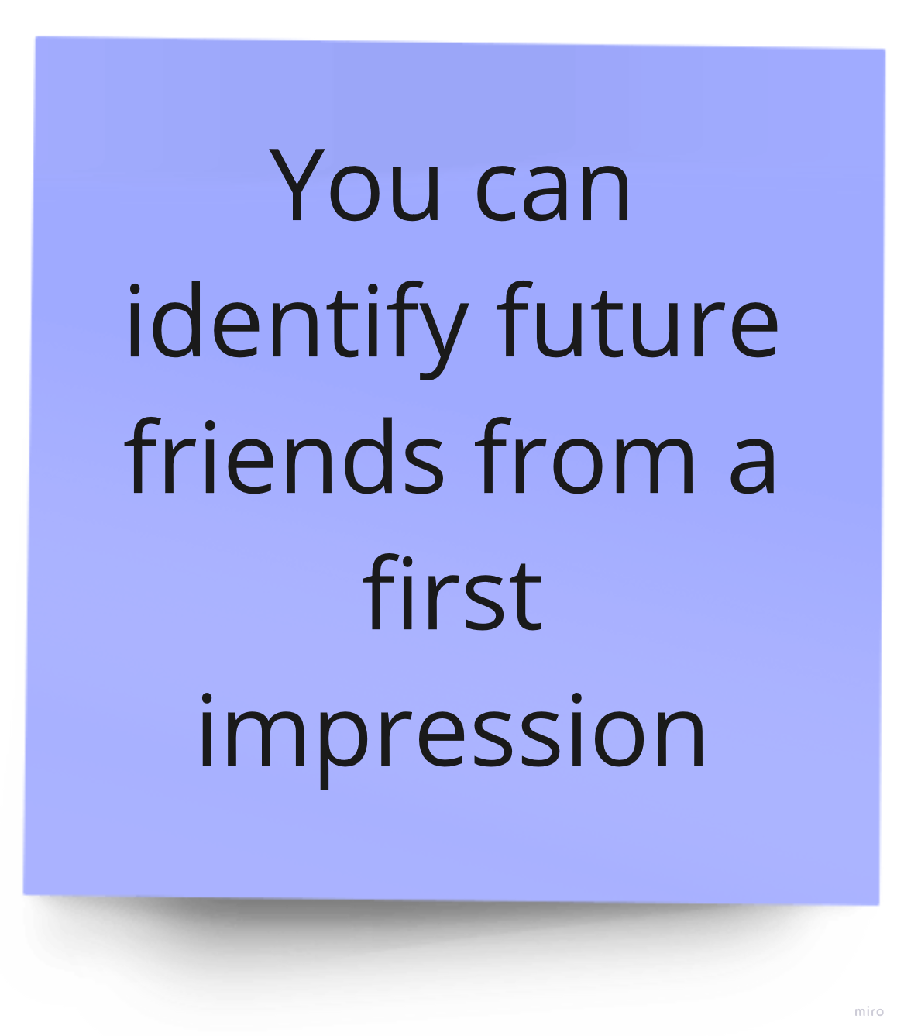
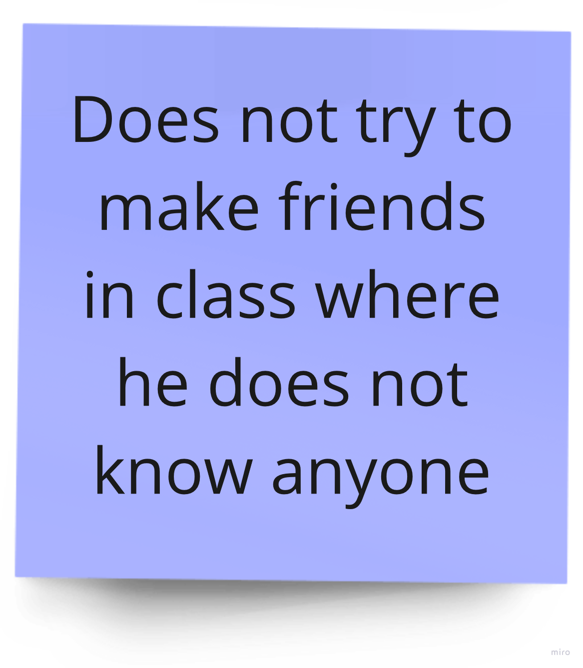
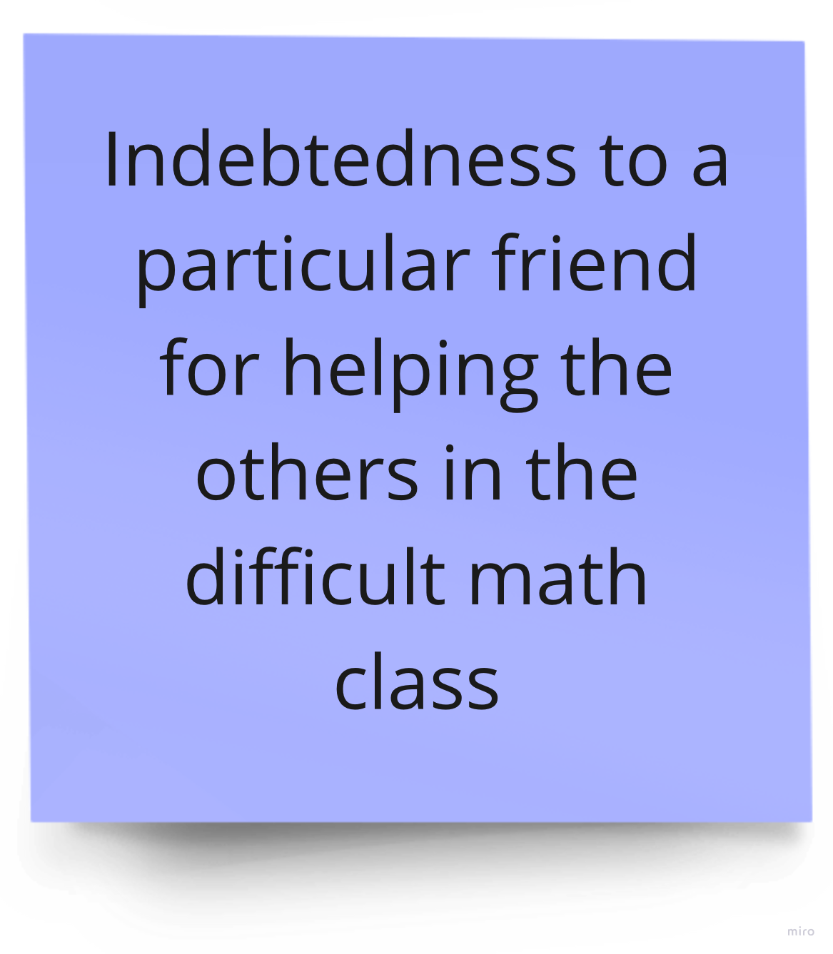

Slide 17
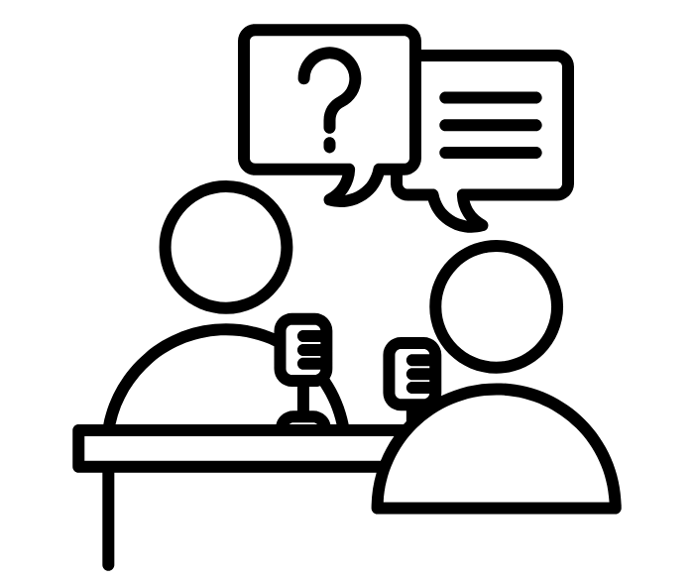
05
INTERVIEW ANALYSIS

Slide 18
Insights & Needs
A surprising contradiction:
He believes collaboration is key to good grades, but works alone in a class where he does not know anyone
Potential needs:
To have a study group in his classes
To “pay forward” the help he received in a difficult class

Slide 19
WE MET…
“Gavin,” a hardworking pre-med student at UC Berkeley who feels he has less prior academic experience than many others.
WE WERE SURPRISED TO NOTICE…
He believes collaboration is key to good grades, but works alone in classes where he does not know anyone.
WE WONDER IF THIS MEANS…
The awkwardness of meeting new people is preventing him from reaching his academic goals.
IT WOULD BE GAME CHANGING IF…
Students felt comfortable working with each other in every class.

Slide 20
Interviews 1, 2, & 4
Key Quotes:
“Whatever they do after, like counselors are more concerned about the people who are barely going to graduate”
“In my favorite class… I felt like I was applying lessons to real life and the community. Also, I appreciated the interaction in the class and working with my peers”
“I think more resources should be provided by the professors in the university, especially if we're paying all that tuition already.”
Surprises:
The interviewee didn’t feel like she had the writing skills required when starting high school
The interviewee sometimes couldn’t find critical study materials, such as old practice tests, until late in the semester by word of mouth.
She expressed that resources for classes or internships were hard to find, but mentioned a few in the interview and was successful in using them

Slide 21

06
SUMMARY

Slide 22

Interview Insights Summary
University support and guidance is severely lacking
Navigating classes and extracurriculars is often confusing
01
02
Connecting with other students to collaborate or share resources can be challenging
A large network aids in finding opportunities but is difficult to build when overwhelmed
03
04

Slide 23
What’s Next?
Assumptions to test:
Whether studying in groups improves grades compared to working alone
That there are many students who wish to form class study groups but do not have one currently
Further perspectives to hear:
Students who do consider themselves “naturally gifted”
Students who use undergraduate education for a primary reason other than getting a degree (for social experiences, athletics, etc)

Slide 24

07
APPENDIX

Slide 25

Interviewee 2
Friend of Interviewee 3 (same interview method
Sophomore at UC Berkeley
Public Health major
Pre-med
Researcher at UCSF
Board member of TEDx club

Slide 26
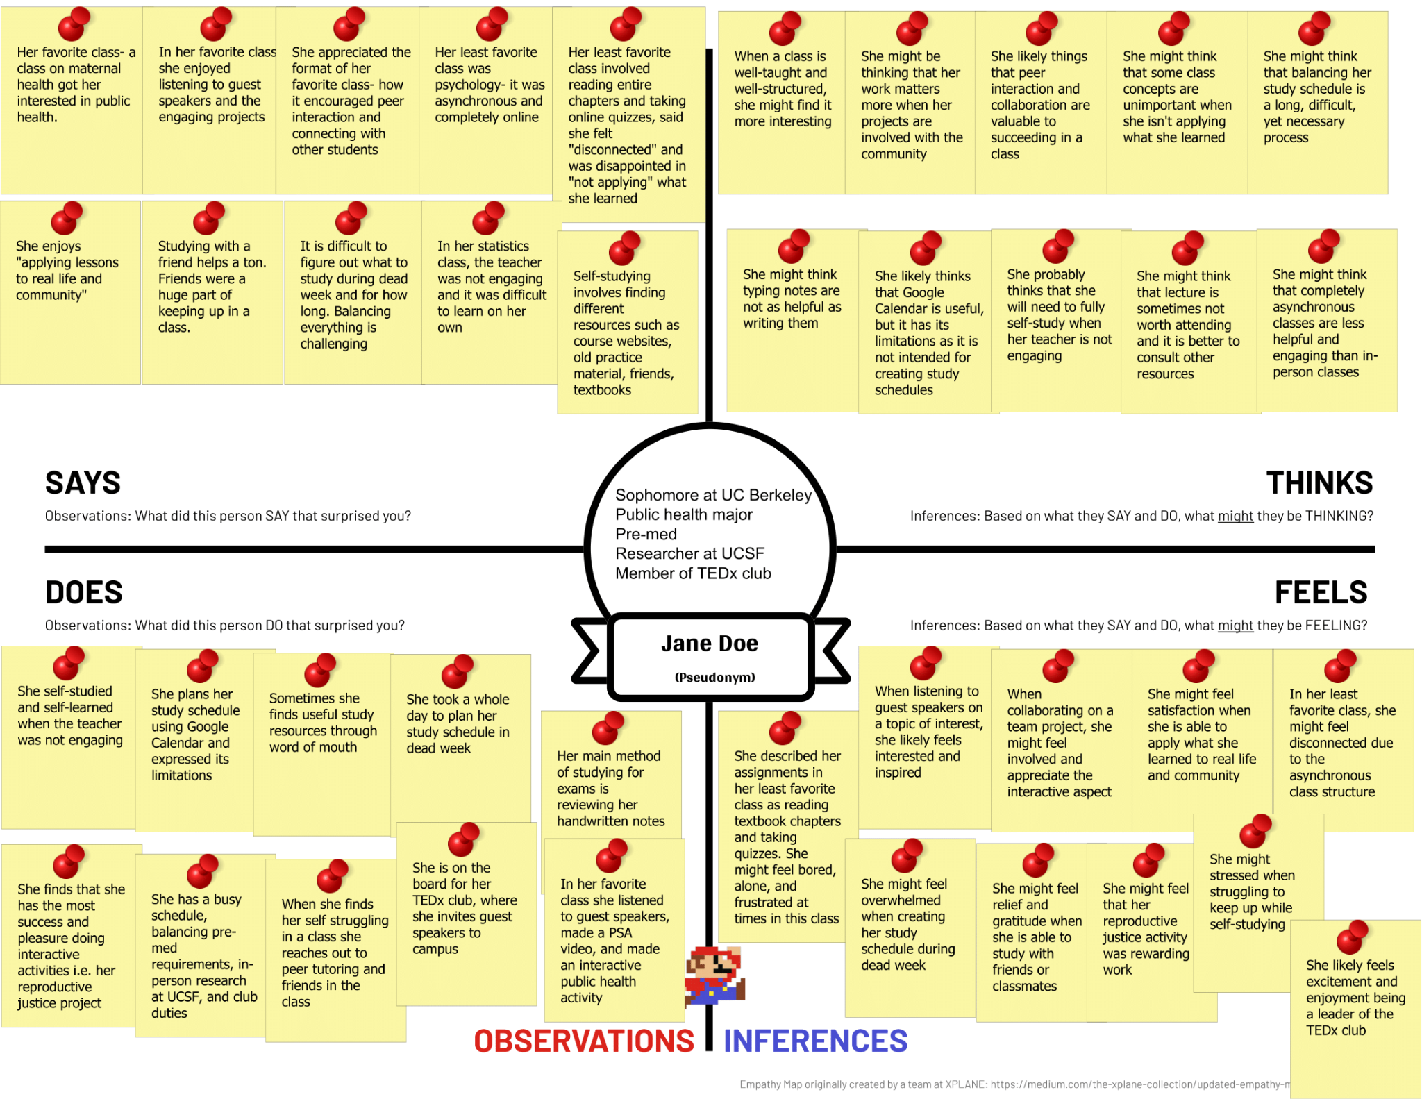
Empathy Map 2

Slide 27
Key Insights
…she enjoys classes that involve “peer interaction” and “applying lessons to real life”
…she will need to fully self-study when class is not engaging
…plan her study schedule using Google Calendar during dead week
…stressed and overwhelmed when figuring out what, when, and how long to study

Slide 28

Interviewee 1
Gap year student (reapplying)
Major undecided
2 years of public high school
2 years of IB
She’s our extreme user (non-user)

Slide 29
Interviewee 1 Details
A friend’s sister from the Bay
Met on Stanford’s campus, at EVGR lobby
AJ as interviewer and Diego as the note taker
Consented to audio recording only
Interview was 52 minutes long
Participant was compensated with a candy bar
Asked questions about their experiences from high school and what they believe affected their success in getting into college
Otter.ai used for transcribing into text
“whatever they do after, like counselors are more concerned about the people who are barely going to graduate” - interview #1
Surprise from interview #1: the interviewee didn’t feel like she had the writing skills required when starting high school

Slide 30
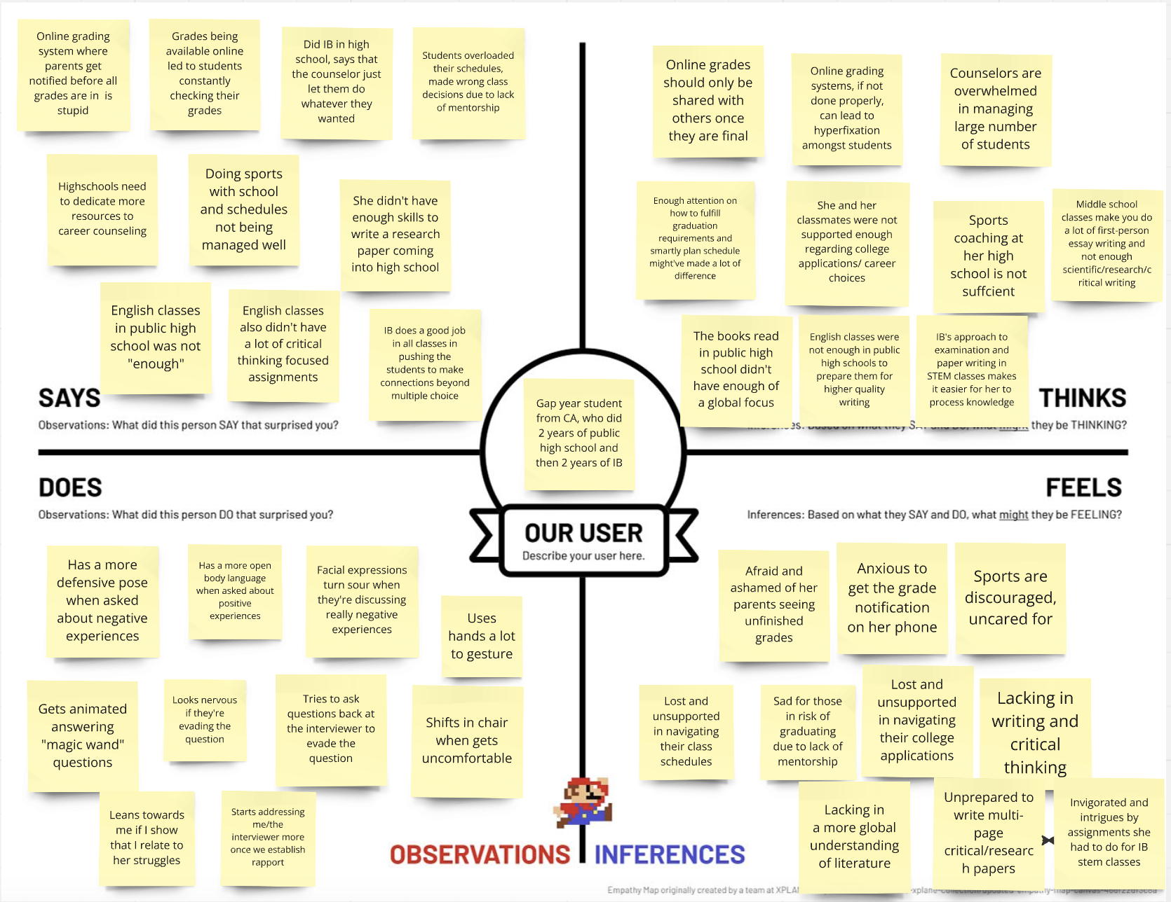
Empathy Map 1
Interviewee 3

Slide 31
Key Insights
…students overloaded their schedules, made wrong class decisions due to lack of mentorship
…counselors are overwhelmed in managing large number of students
Interviewee 3
…leans more towards me/ the interviewer if I show that I relate to her struggles
…lost and unsupported in navigating their class schedules, college applications, and grad requirements

Slide 32


Interviewee 4
Recent 2024 Graduate from UC Davis
Bay Area Resident
BS in Environmental Science and Management and a minor in Environmental Policy Analysis and Planning
Works for National Zoning Atlas, related to Urban Planning
Adobe Stock Image

Slide 33
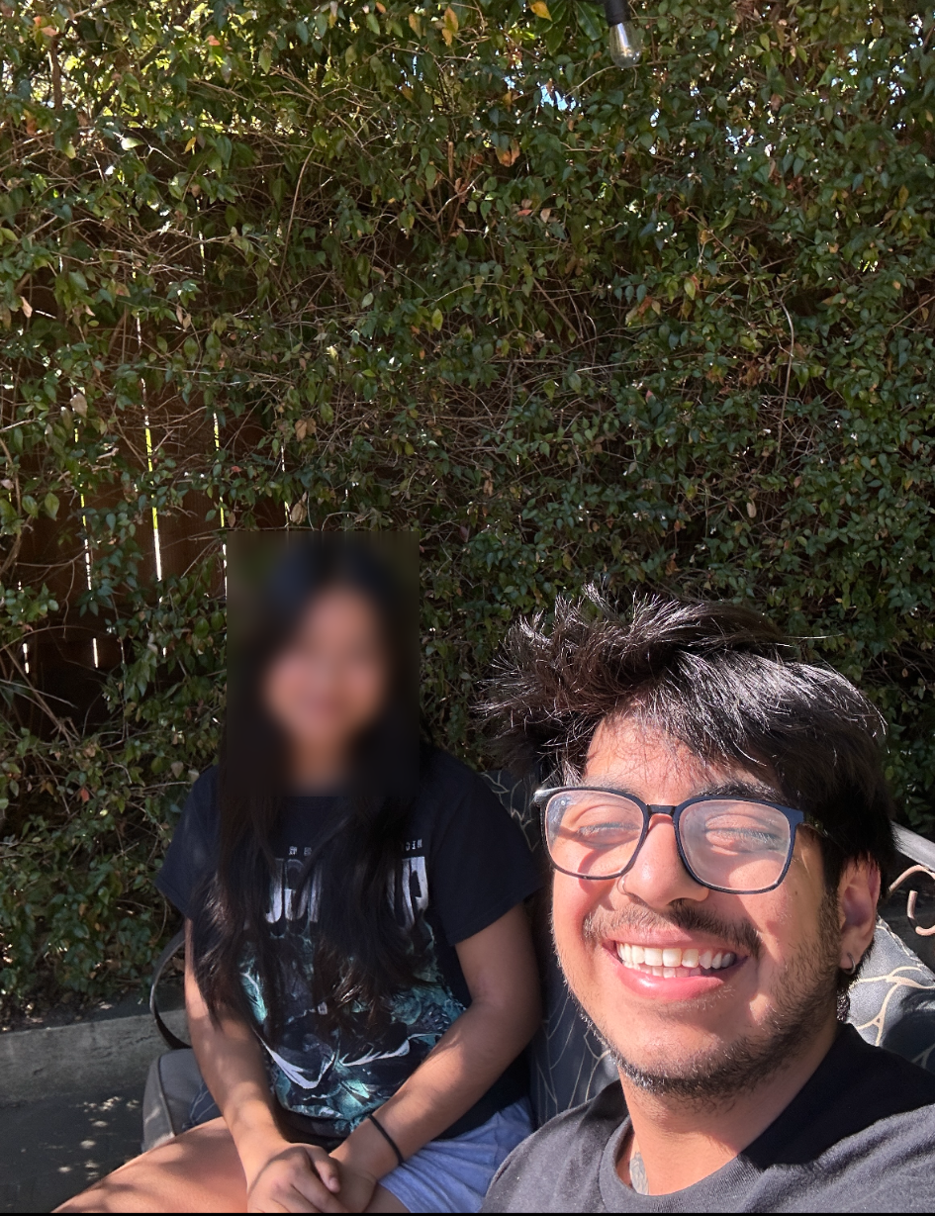
Interviewee 4 Details
Friend of a friend from the Bay
Met at a park nearby their residence
Built rapport over lunch first and came back to part to do the interview
Diego as interviewer and AJ as the note taker
Consented to audio and video recording, but only recorded audio on bench
Interview was 48 minutes long
Participant was compensated by paying for their lunch (as agreed upon)
Asked questions about their experiences from the start of college through graduation and into their job search and employment
Otter.ai used for transcribing into text
Image of us at restaurant with faces blurred

Slide 34
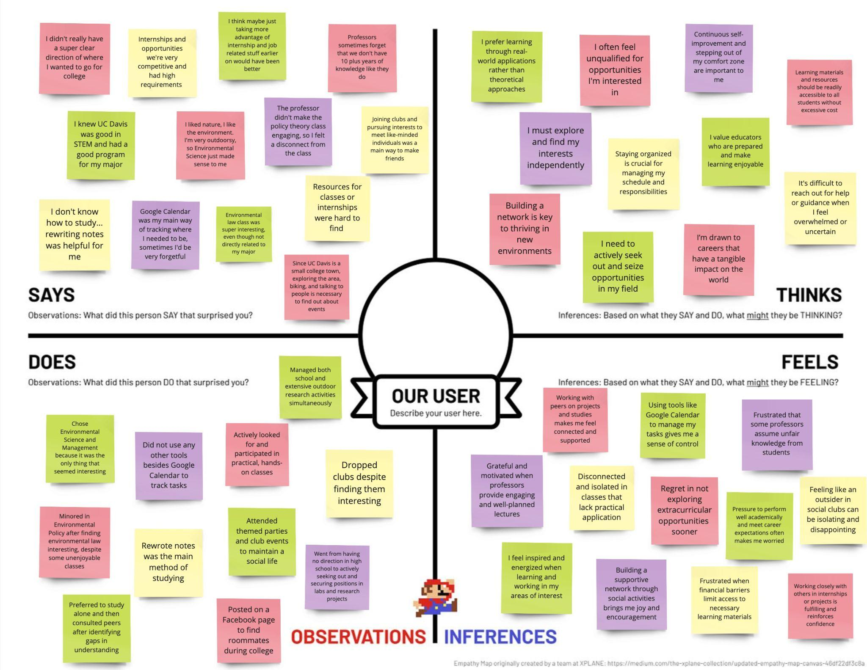

Empathy Map 4
Sofia
(Pseudonym)

Slide 35


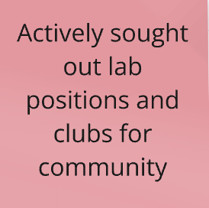
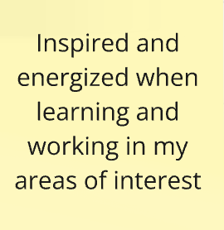
Key Insights
Sofia
(Pseudonym)

